Slide 1

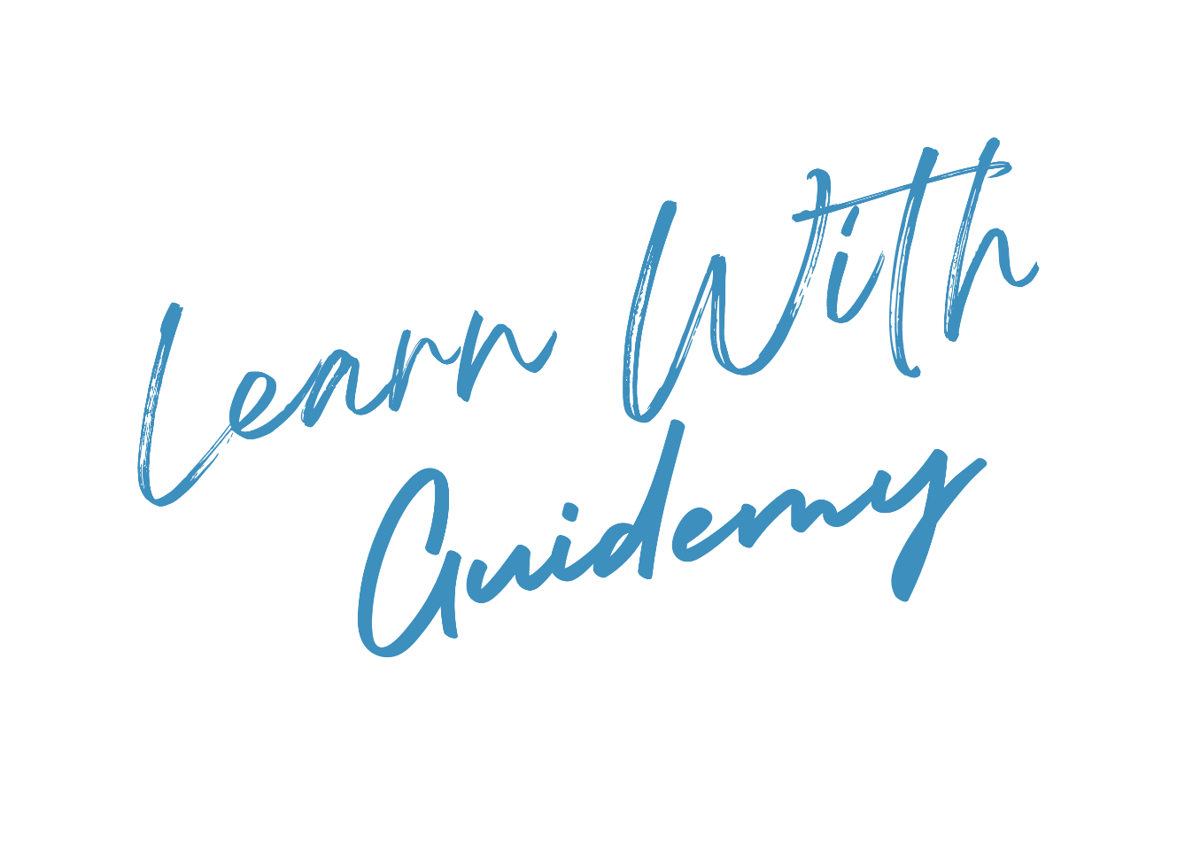
Speaker: Rishi S.
SOLID Principles

Slide 2

Objectives
After this module you will be able to:
Understand the SOLID Principles
Apply the Single Responsibility Principle
Utilize the Open-Closed Principle
Adhere to the Liskov Substitution Principle
Implement the Interface Segregation Principle
Incorporate the Dependency Inversion Principle

Slide 3

Introduction
Single Responsibility Principle
Open-Closed Principle
Liskov Substitution Principle
Interface Segregation Principle
Dependency Inversion Principle

Slide 4

Introduction
Introduction to SOLID
The word SOLID is an acronym for:
S: Single Responsibility Principle
O: Open-Closed Principle
L: Liskov Substitution Principle
I: Interface Segregation Principle
D: Dependency Inversion Principle
SOLID design principles encourage us to create more maintainable, understandable, and flexible software.
Consequently, as our applications grow in size, we can reduce their complexity and save ourselves a lot of headaches further down the road!
SOLID Principles

Slide 5
Introduction
Single Responsibility Principle
Open-Closed Principle
Liskov Substitution Principle
Interface Segregation Principle
Dependency Inversion Principle

Slide 6
Single Responsibility Principle
What is Single Responsibility Principle?
A class should ONLY have one responsibility. Furthermore, it should only have one reason to change.
Benefits:
Testing – A class with one responsibility will have fewer test cases
Lower coupling – Less functionality in a single class will have fewer dependencies
Organization – Smaller, well-organized classes are easier to search than monolithic ones
SOLID Principles

Slide 7
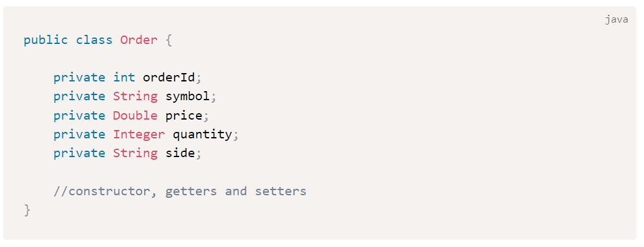
Single Responsibility Principle
Example - Order
SOLID Principles

Slide 8
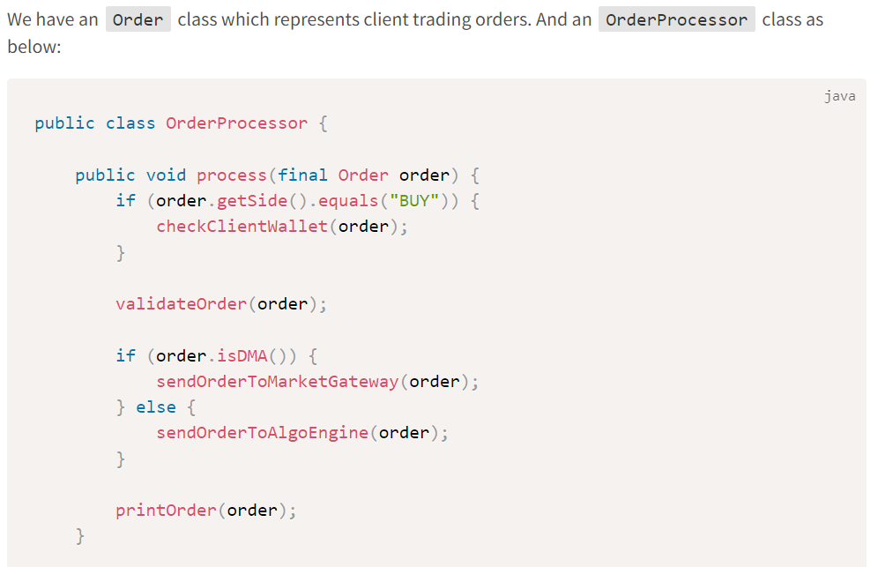
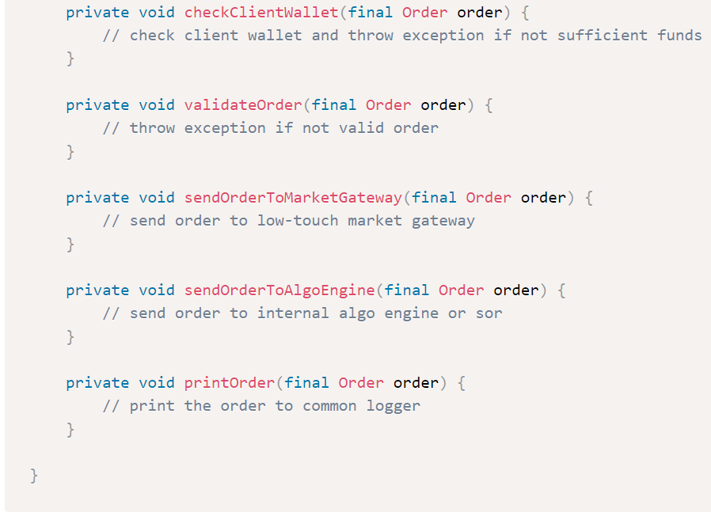
Single Responsibility Principle
Example - OrderProcessor
SOLID Principles

Slide 9
Single Responsibility Principle
Violation of the SRP Principle
In OrderProcessor class, we can see there are many reasons for this class to change.
If client wallet check logic changes, we need to change the class
If order validation rules changes, we need to change the class
If sending order to market-gateway or algo-engine routing changes, we need to change the class
Even if printing the order fields change, we need to change the class
This definitely breaks the SRP principle.
SOLID Principles

Slide 10
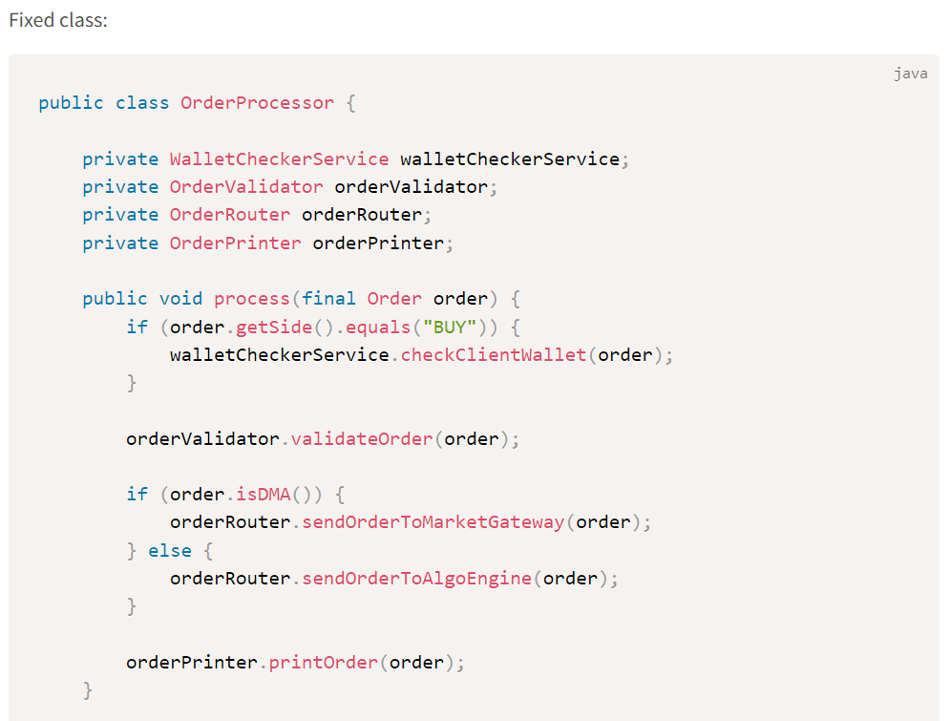
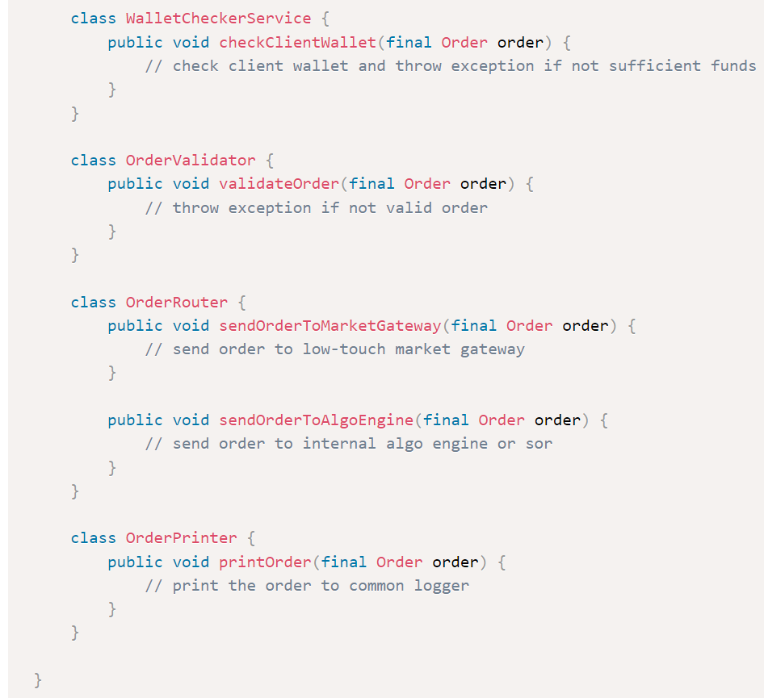
Single Responsibility Principle
SOLID Principles

Slide 11
Introduction
Single Responsibility Principle
Open-Closed Principle
Liskov Substitution Principle
Interface Segregation Principle
Dependency Inversion Principle

Slide 12
Open-Closed Principle
What is Open-Closed Principle?
Classes should be open for extension but closed for modification.
In doing so, we stop ourselves from modifying existing code and causing potential new bugs in an otherwise happy application.
One exception to the rule is when fixing bugs in existing code.
SOLID Principles

Slide 13
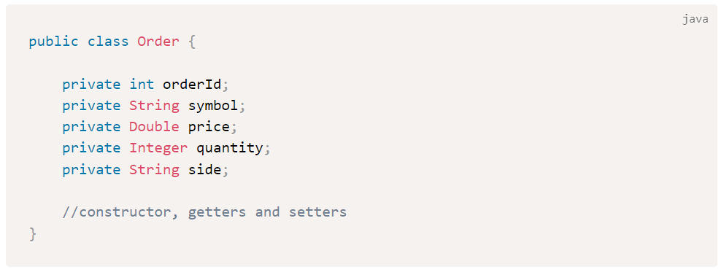
Open-Closed Principle
Example - Order
Let’s take the same example class Order, which has been working fine so far in our order management system.
SOLID Principles

Slide 14
Open-Closed Principle
Adding Order Features
Now suppose we started specific order features required for DMA (direct market access) or Algo order (VWAP, TWAP, etc.).
It might be tempting to just open up the Order class and add fields pertaining to DMA or Algo orders — but this may cause errors and might throw up in our application which was already working fine.
SOLID Principles

Slide 15
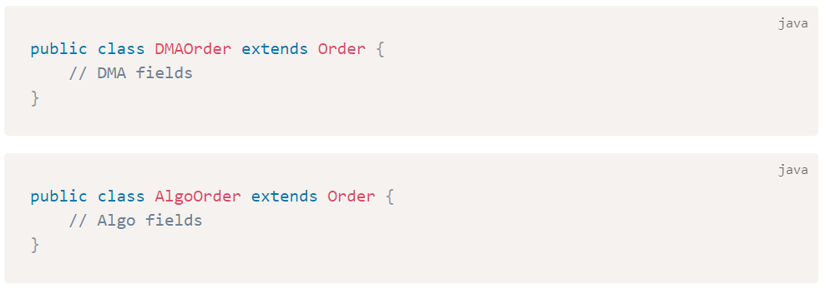
Open-Closed Principle
Use Inheritance
So, to fix this and applying open-close principle => we should use inheritance.
Thus, we can say that Order class is now open for extension (by inheritance) and closed for modification.
SOLID Principles

Slide 16
Introduction
Single Responsibility Principle
Open-Closed Principle
Liskov Substitution Principle
Interface Segregation Principle
Dependency Inversion Principle

Slide 17
Liskov Substitution Principle
What is Liskov Substitution Principle?
This principle states that “Derived or child classes must be substitutable for their base or parent classes”.
In other words, if class A is a subtype of class B, then we should be able to replace B with A without interrupting the behavior of our program.
SOLID Principles

Slide 18
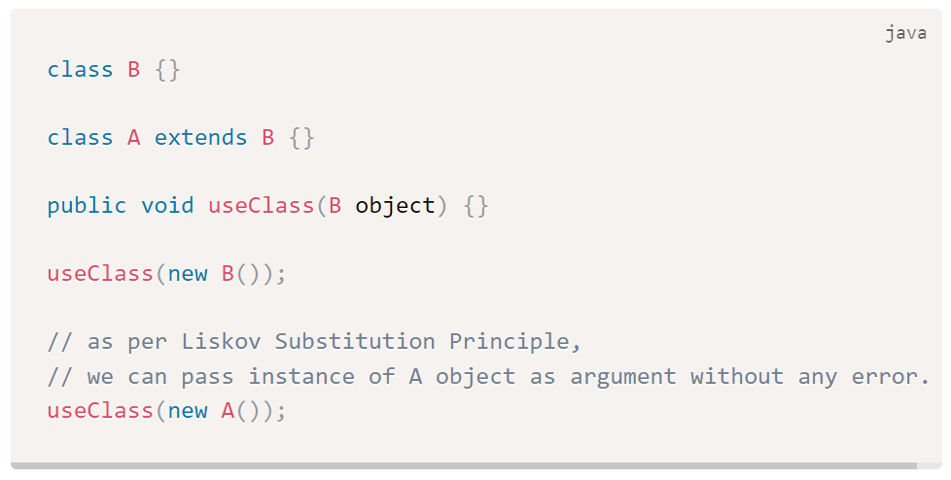
Liskov Substitution Principle
What is Liskov Substitution Principle?
SOLID Principles

Slide 19
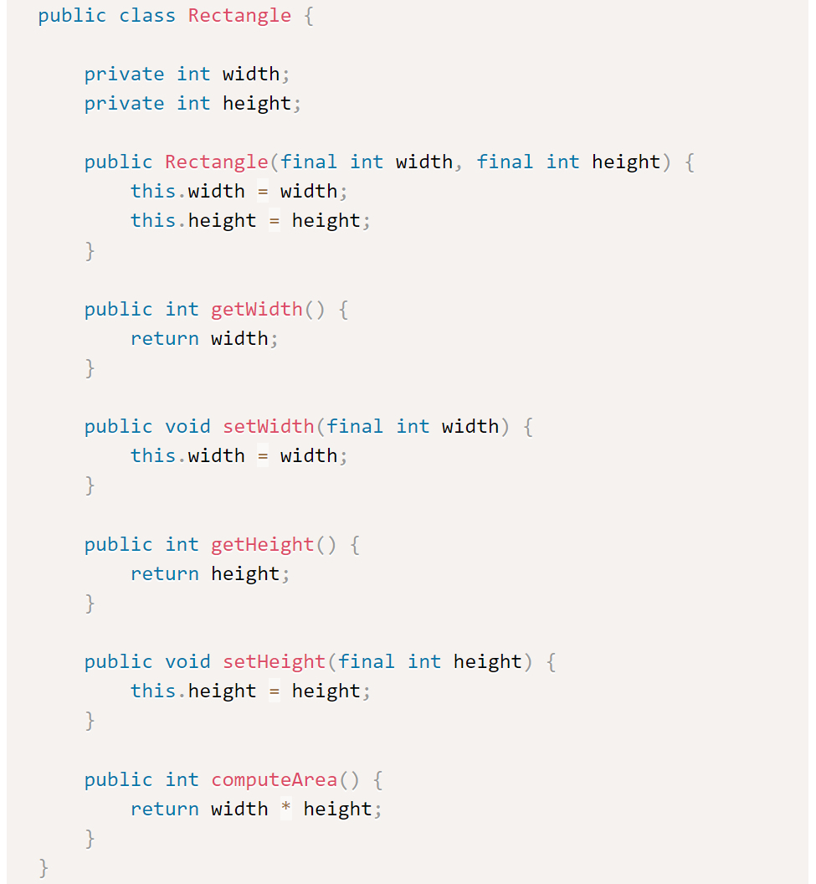
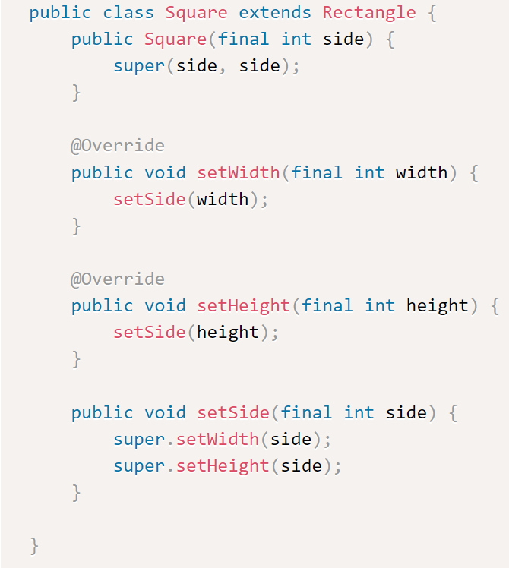
Liskov Substitution Principle
Let’s demonstrate the same using actual classes:
A Rectangle class and a child class Square
SOLID Principles

Slide 20
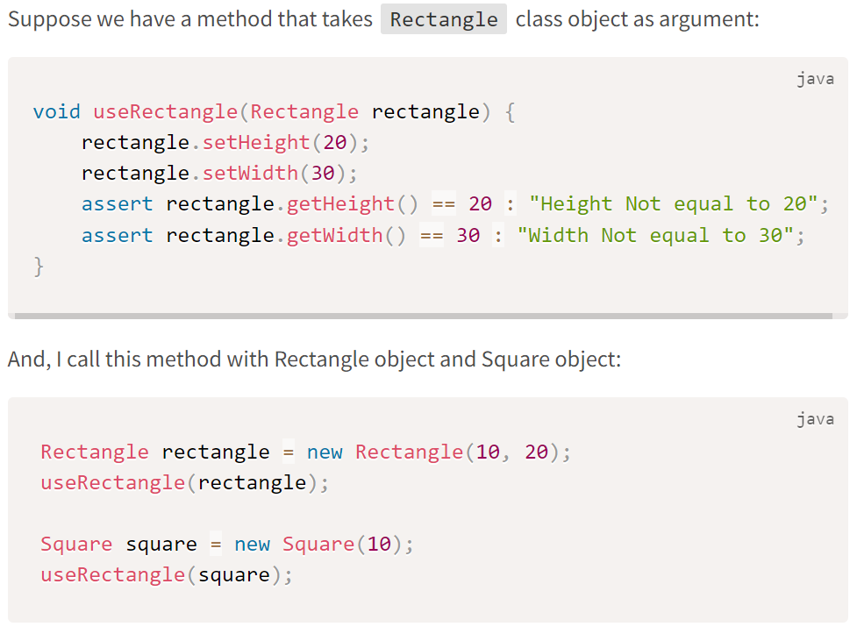
Liskov Substitution Principle
SOLID Principles

Slide 21
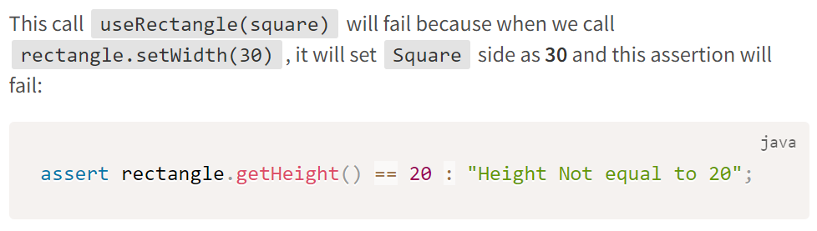
Liskov Substitution Principle
SOLID Principles

Slide 22
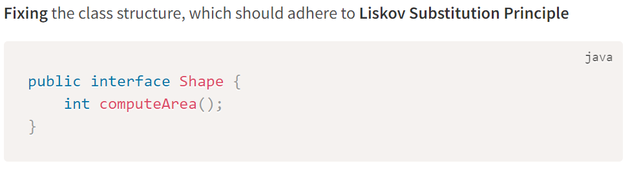
Liskov Substitution Principle
SOLID Principles

Slide 23
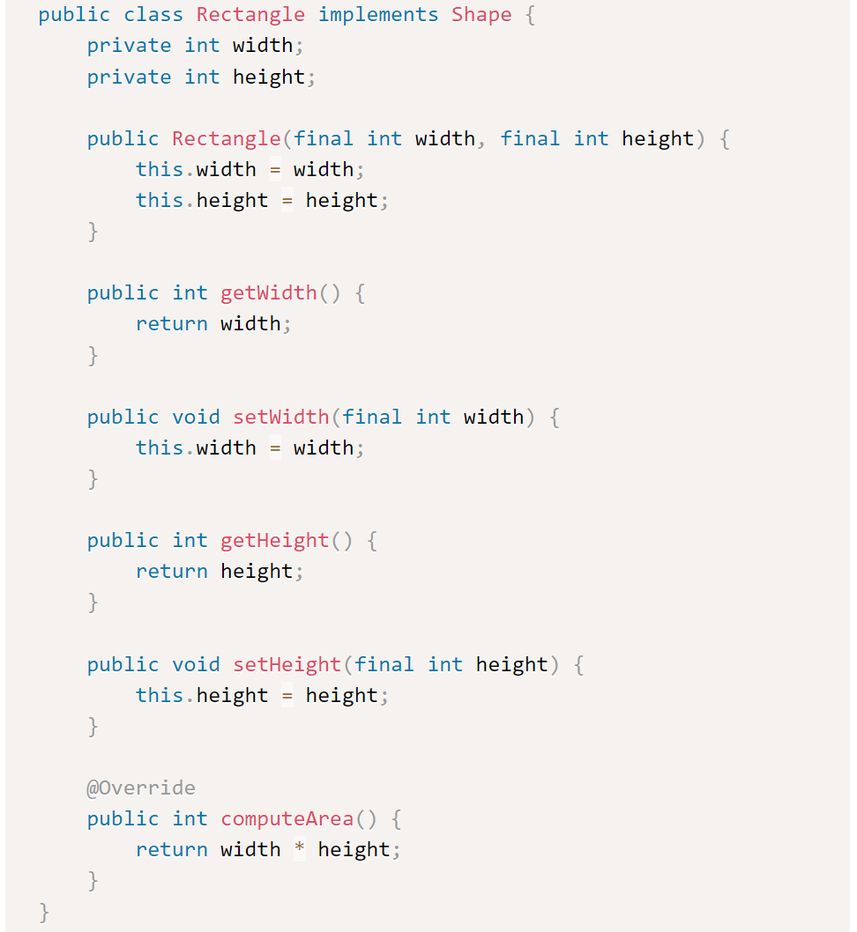
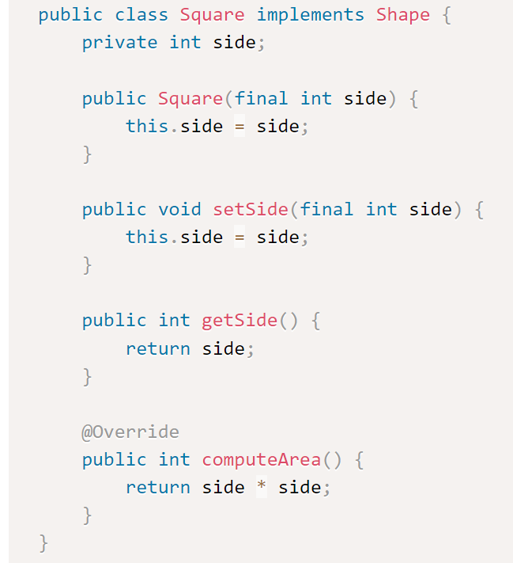
Liskov Substitution Principle
SOLID Principles

Slide 24
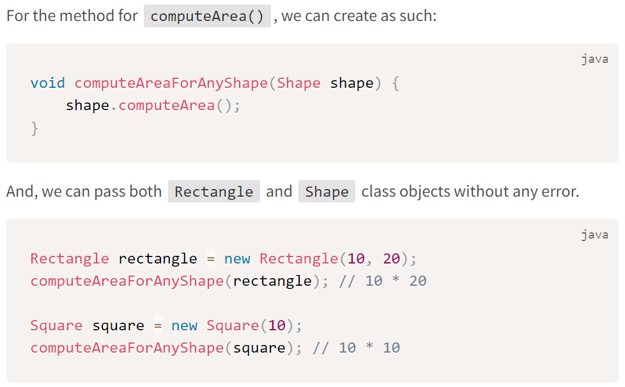
Liskov Substitution Principle
SOLID Principles

Slide 25
Introduction
Single Responsibility Principle
Open-Closed Principle
Liskov Substitution Principle
Interface Segregation Principle
Dependency Inversion Principle

Slide 26
Interface Segregation Principle
What is Interface Segregation Principle?
Larger interfaces should be split into smaller ones.
By doing so, we can ensure that implementing classes only need to be concerned about the methods that are of interest to them.
SOLID Principles

Slide 27
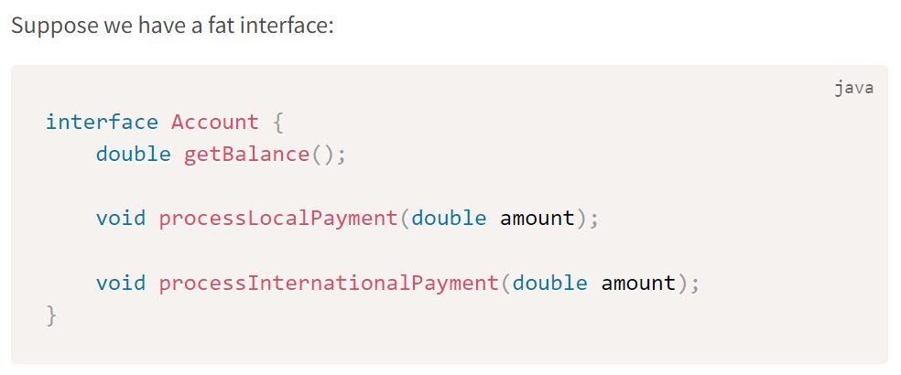
Interface Segregation Principle
Example - Account
SOLID Principles

Slide 28
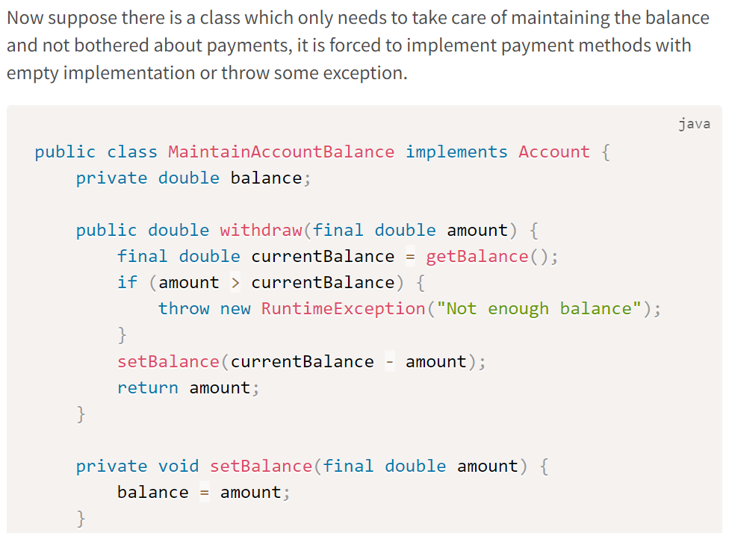
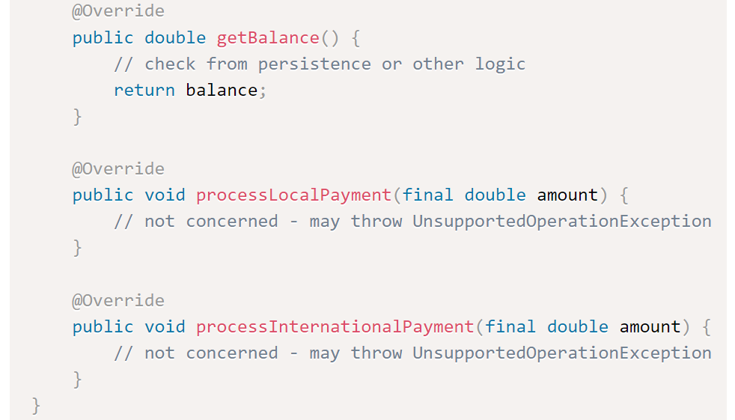
Interface Segregation Principle
Example - Account
SOLID Principles

Slide 29
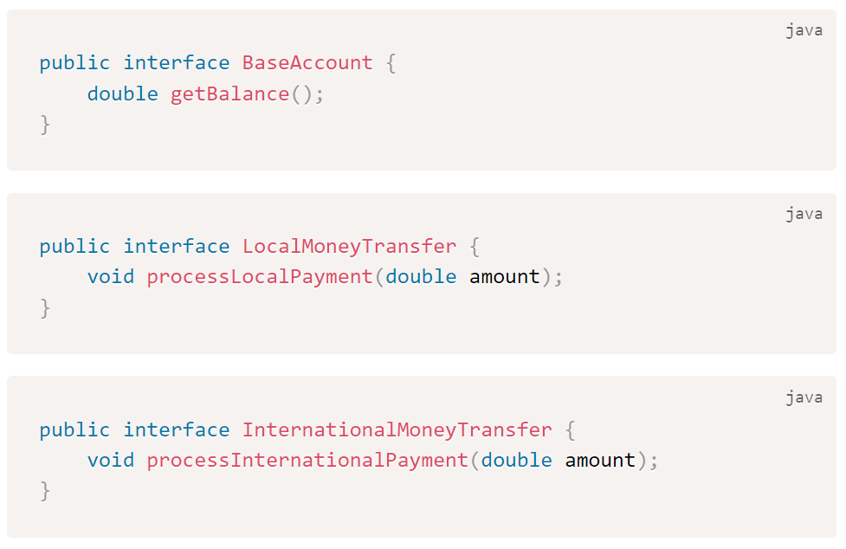
Interface Segregation Principle
Example - Account
This is breaking Interface Segregation Principle.
Fixing is just to break the Account interface into 3 smaller interfaces.
Now we can separate classes dedicated to implementation of each above functions creating cleaner code and highly cohesive classes.
It also applies Single Responsibility Principle for a class.
SOLID Principles

Slide 30
Introduction
Single Responsibility Principle
Open-Closed Principle
Liskov Substitution Principle
Interface Segregation Principle
Dependency Inversion Principle

Slide 31
Dependency Inversion Principle
What is Dependency Inversion Principle?
The principle of dependency inversion refers to the decoupling of software modules.
This way, instead of high-level modules depending on low-level modules, both will depend on abstractions.
Because abstractions do not depend on details, but details depend on abstractions, it decouples the software.
SOLID Principles

Slide 32
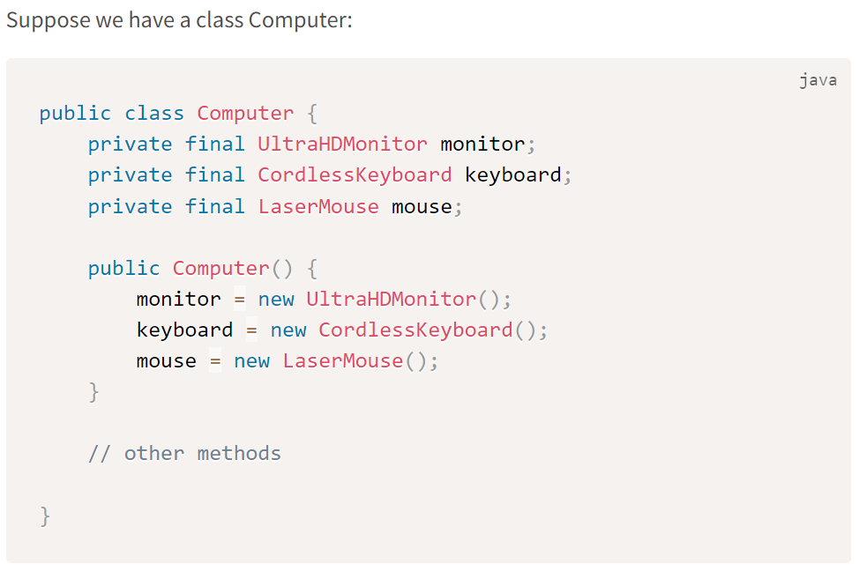
Dependency Inversion Principle
Example – Tight Coupling
This code will work, but by declaring the UltraHDMonitor, CordlessKeyboard and LaserMouse with the new keyword in the constructor, we’ve tightly coupled these 4 classes together.
Not only does this make our Computer class hard to test, but we’ve also lost the ability to switch out our UltraHDMonitor, CordlessKeyboard and LaserMouse classes with a different one should the need arise.
SOLID Principles

Slide 33
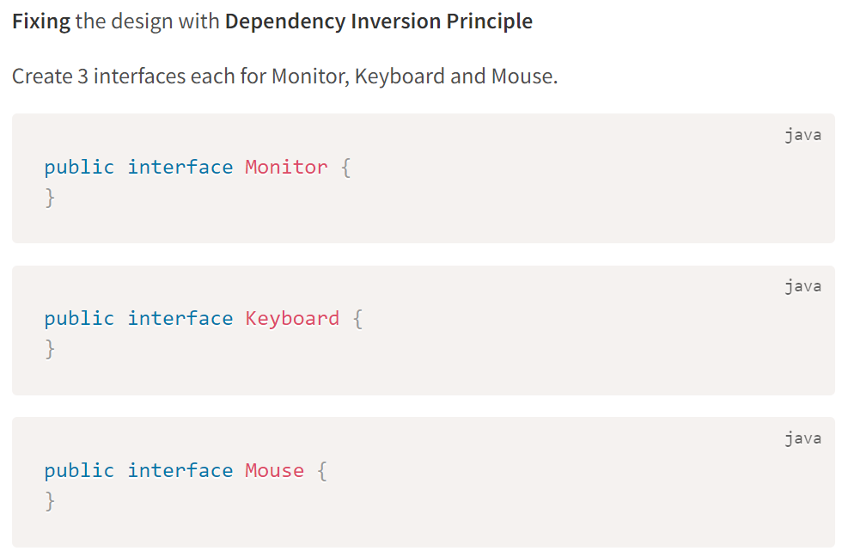
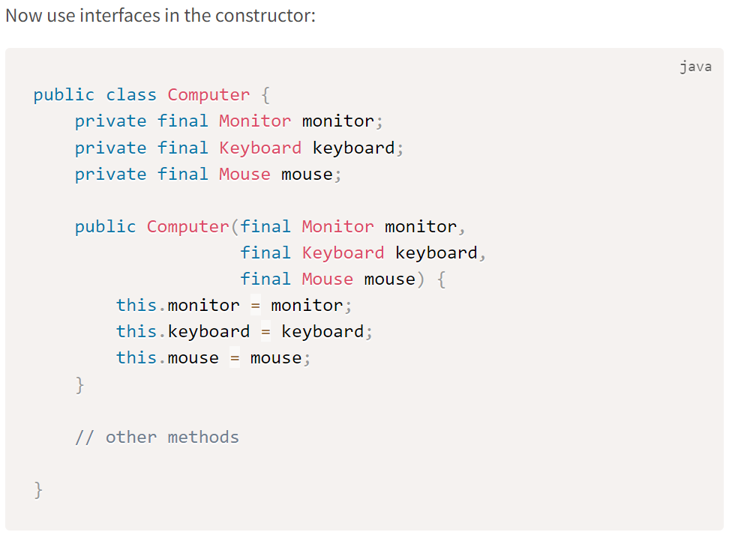
Dependency Inversion Principle
Example – Fixing It
SOLID Principles

Slide 34
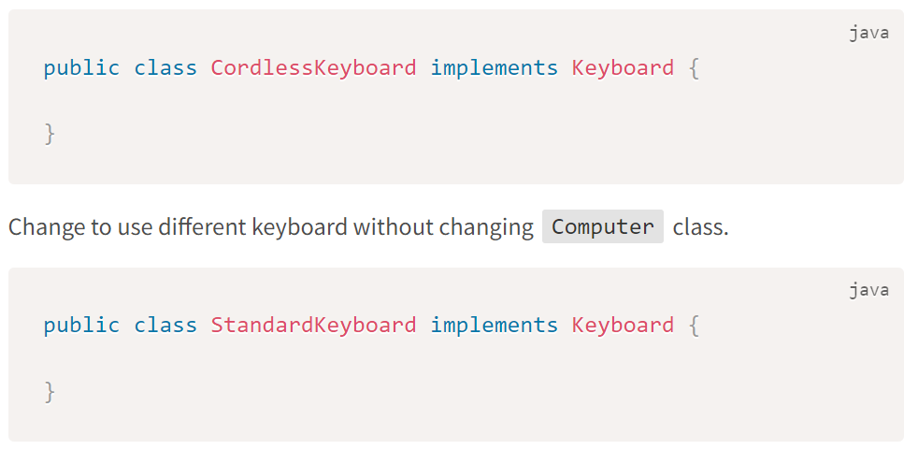
Dependency Inversion Principle
Example – Fixing It
Here, we’re using the dependency injection pattern to facilitate adding the Monitor, Keyboard and Mouse dependencies into the Computer class.
Our individual classes can implement these interfaces. And suppose if we want, we can easily switch out the type of keyboard in our machine with a different implementation of the interface.
SOLID Principles

Slide 35

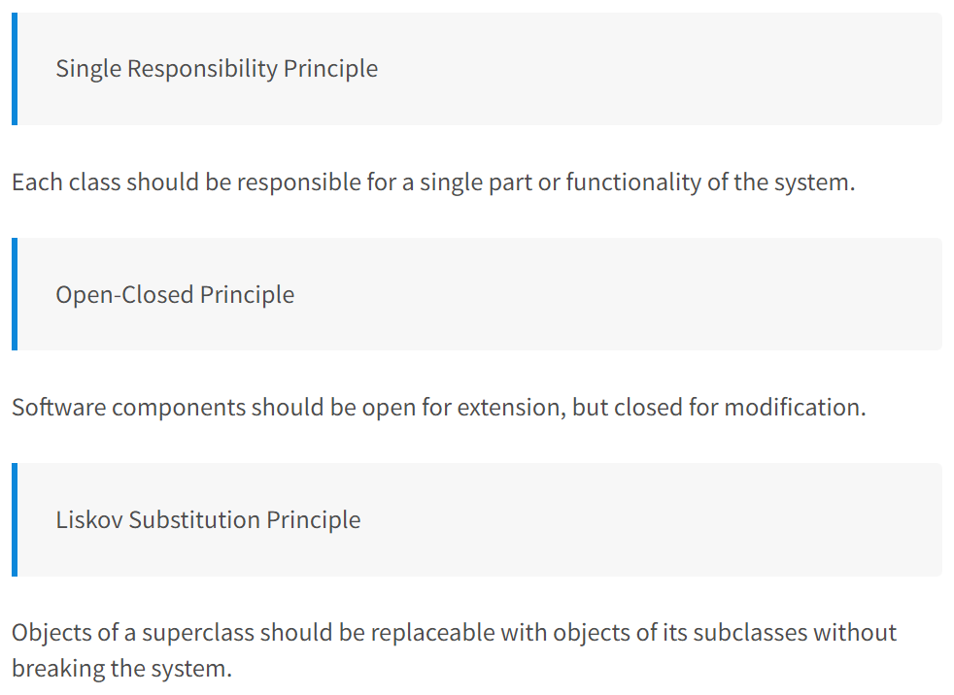
Summary

Slide 36
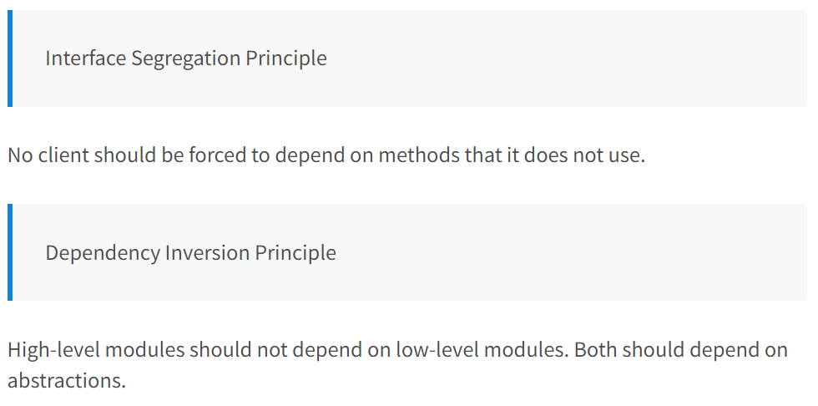
Summary

